Slide 1

Final Presentation -
Impact on Gun Industries Stock after Mass Shooting
Javier Sanmiguel, Madhu Mudigonda, Shainu Prakash, and Thanigaivel Shanmugam
07/16/2022

Slide 2

Agenda
Project
Background
Overview & Hypothesis
Data
Data Origin
Data Preparation
Key Variables
Challenges / Interesting Finds
Modeling
Model Approach
Model Selection
Models with Transformation
Model Plots (Regression & Diagnostic)
Model Metrics
Final Model
Conclusion
Interesting Expenditures to Pursue
Key Takeaways
Source Cited

Slide 3
Project

Slide 4
Background
According to GunArchive, in 2022 there were:
337 Mass Shootings so far
Number of Children (age 0-11)
Killed = 186
Number of Teens (age 12 - 17)
Killed = 716
Do these events have an impact on the stocks of Gun Industries?
Note:
Gun Archive considers 3+ people killed as Mass Shooting event.

Slide 5
Overview & Hypothesis
Overview The team is trying to identify the impact on gun industries return after a mass shooting
Hypothesis
A general perception is that the gun stocks/return will be impacted after a Mass Shooting event

Slide 6
Data

Slide 7
Data Origin - US Mass Shooting
Mass Shooting data were exported from Kaggle.
Variables selected from the dataset are the following
Location
State
Date
Year
Fatality
Injured
Total Victims

Slide 8
Data Preparation - US Mass Shooting
Updated the date if the shooting event happened on a weekend.
Saturday = Event Date + 2, which is Monday
Sunday = Event Date + 1, which is Monday
Created Column to identify the State based on the Location column
Updated a data row with the most up-to-date data for Uvalde shooting
Number of fatalities
Number of injured
Total victims

Slide 9
Data Origin - Stock Prices
Stock Prices imported from tidyquant
Imported stock prices of 6 gun stocks for the last 10 years.
Sturm, Ruger & Company, Inc (RGR)
Smith & Wesson Brands, Inc. (SWBI)
Olin Corporation (OLN)
National Presto Industries, Inc. (NPK)
Big 5 Sporting Goods Corporation (BGFV)
Axon Enterprise, Inc. (AXON)
Variables available in the dataset are
Open
High
Low
Close
Volume
Adjusted

Slide 10
Data Preparation - Stock Prices
Additional Stock data is imported from Yahoo finance
Portfolio created based on market capitalization weights
Calculated technical indicators - SMA
Calculated technical indicator MOM - Momentum

Slide 11
Feature Engineering
Imputation
Handled mass shooting events that occurred on weekends
Transformation
Cleaned the mass shooting data to get the location and dates field
Created Portfolio return for portfolio gun industry stocks
Calculated SMA- Short and Long
Calculated Momentum
Notes:
What models did we think about and why we chose Linear Regression?

Slide 12
Key Variables
Merged Gun industry stock data with US mass shooting using event dates.
Key Variables | Type | Notes
Mass Shooting Event Date | Independent
Number of Fatalities | Independent
Total Injured | Independent
Total Victims | Independent
Adjusted Close Price | Dependent | Adjusted close price of the gun industry stocks.
Portfolio Returns of the Gun Stocks | Dependent | Used Market Cap Weights to create the Portfolio.

Slide 13
Key Variables
Key Variables | Type | Notes
Simple Moving Average (SMA - Short 2 days) | Dependent | Calculated from Portfolio Returns
Simple Moving Average (SMA - Long 15 days) | Dependent | Calculated from Portfolio Returns
Momentum of the portfolio returns (2,3,5,10,15 and 20) | Dependent | Calculated from Portfolio Returns

Slide 14
Challenges / Interesting Finds
The stock market is closed on the weekends and holidays, so we had to shift the event dates to next trading day of the stock market
Initially we started with 10 companies, but due to limited stock history we dropped it to 6 companies
Many of the companies cater to multiple markets like sporting goods, safety goods not just guns
There are only two gun manufacturers publicly traded in the USA. the great majority are private companies

Slide 15
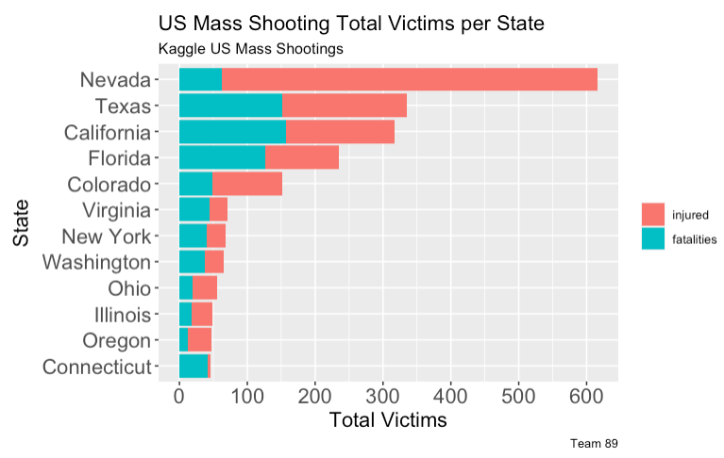
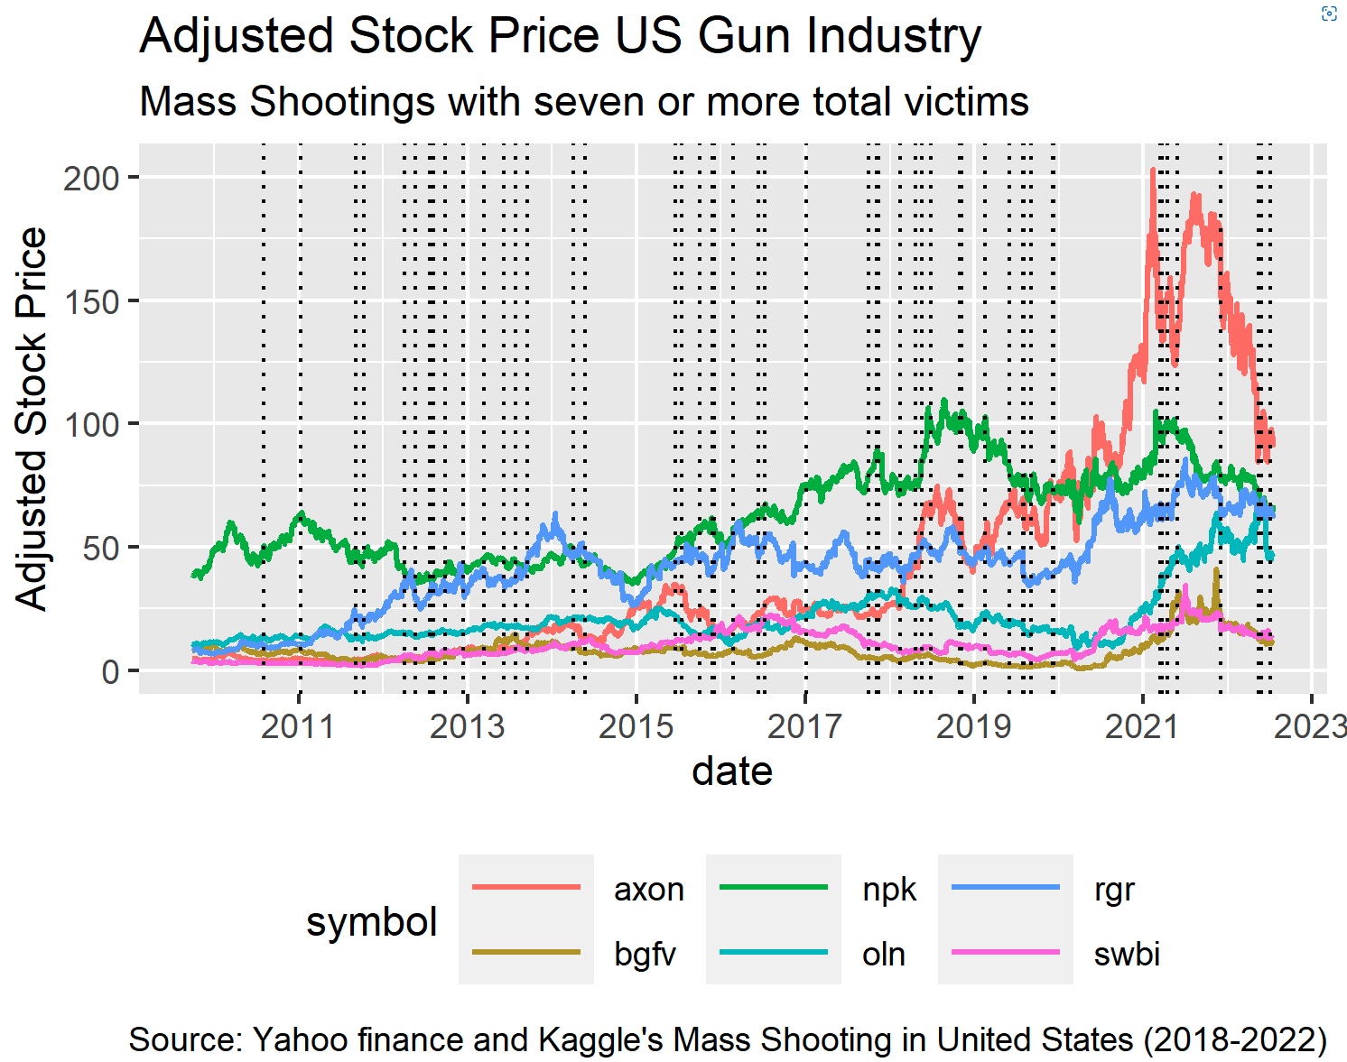
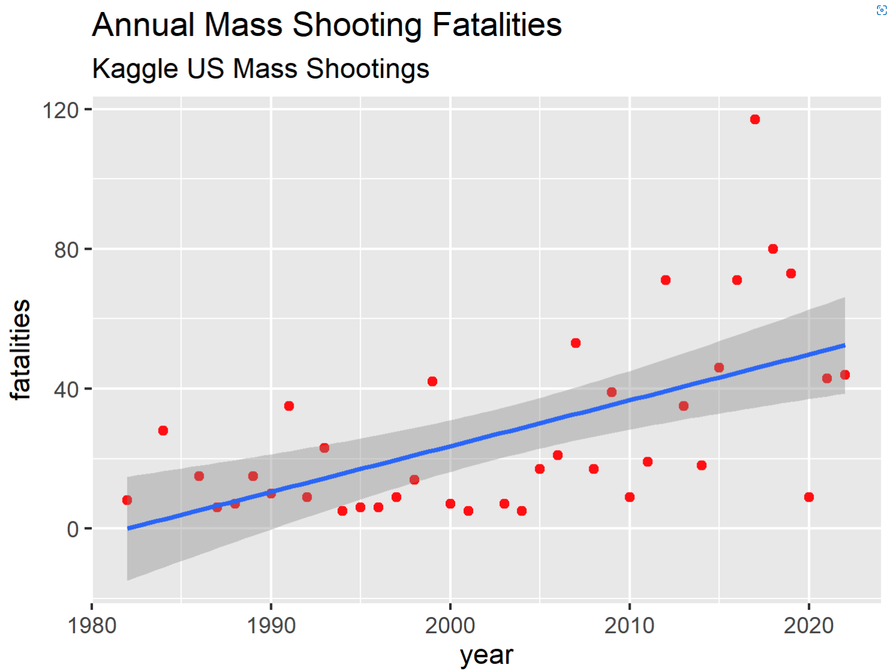
Data Charts

Slide 16
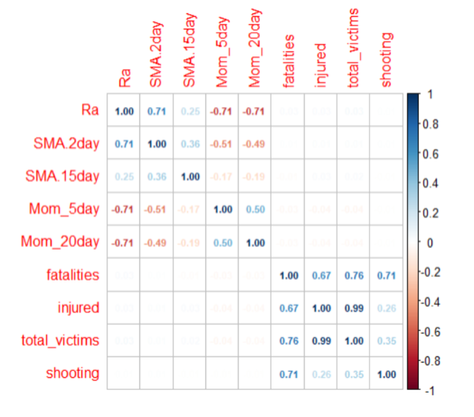
Correlation plot
Based on the analysis we will be considering the below parameters for modeling
Injured
Fatalities
SMA
Momentum
Notes:
Fatalities and injured are highly correlated. We combined them into a derived variable - total_victims. We will be

Slide 17
Modeling

Slide 18
Modeling Approach
Hypothesis : Negative impact on Market returns
Linear regression
Initial hypothesized model:
Portfolio Return ~ # injured + fatalities per shooting
Portfolio Return ~ SMA and Momentum
Dataset: Time series data of US Mass shooting events + Top Gun Industry stocks
Training data: 2010-01-01 to 2019-12-31
Test data: 2020-01-01 to 2022-06-15
Notes:
What models did we think about and why we chose Linear Regression?

Slide 19
Model Selection Process
 | Model Formula | R² | Adjusted R² | p-values
Model 1 | SMA_2day ~ fatalities + injured Coeffs: intercept:8.629e^-04, fatalities: 3.240e^-05, injured:1.754e^-05 | 0.0002287 | -0.0005667 | fatalities = 0.88505, injured = 0.66125
Model 2 | SMA_15day ~ fatalities + injured Coeffs: intercept:8.629e^-04, fatalities: -1.885e^-04, injured:4.039e^-05 | 0.003216 | 0.002423 | fatalities = 0.01993*, injured = 0.00525**
Model 3 | MOM_5day ~ fatalities + injured Coeffs: intercept:5.290e^-05, fatalities: -4.487e^-05, injured:-1.294e^-04 | 0.00211 | 0.001316 | fatalities = 0.921, injured = 0.110
Model 4 | MOM_20day ~ fatalities + injured Coeffs: intercept:1.077e^-04, fatalities: -4.569e^-04, injured:-6.590e^-05 | 0.002109 | 0.001315 | fatalities = 0.317, injured = 0.419
Model 5 | SMA_2day ~ total_victims Coeffs: intercept:8.645e^-04, total_victims: 1.934e^-05 | 0.0002273 | -0.0001702 | total_victims = 0.44962
Model 6 | SMA_15day ~ total_victims Coeffs: intercept:8.645e^-04, total_victims: 1.259e^-05 | 0.0007356 | 0.0003383 | total_victims = 0.174
Model 7 | MOM_5day ~ total_victims Coeffs: intercept:6.203e^-05, total_victims: -1.191e^-04 | 0.0021 | 0.001703 | total_victims = 0.0215*
Model 8 | MOM_20day ~ total_victims Coeffs: intercept:6.550e^-05, total_victims: -1.134e^-04 | 0.00188 | 0.001484 | total_victims = 0.0296*
Notes:
Further go through EDA

Slide 20
Models With Transformation
 | Model Formula | R² | Adjusted R² | p-values
Model 8.a | MOM_20day ~ log(total_victims + 1) Coeffs: intercept:0.0001114, log(total_victims + 1): -0.0022919 | 0.0007297 | 0.0003324 | log(total_victims + 1) = 0.175
Model 8.b | log(MOM_20day + c +1) ~ total_victims c: abs(min(mom_20day) Coeffs: intercept: 1.663e^-01, total_victims: -9.859e^-05 | 0.001974 | 0.001577 | total_victims = 0.0258*
Model 8.c | log(MOM_20day + c +1) ~ log(total_victims + 1) Coeffs: intercept: 0.1663123, log(total_victims + 1): -0.0020589 | 0.0008177 | 0.0004204 | log(total_victims + 1) = 0.152
Notes:
Further go through EDA

Slide 21

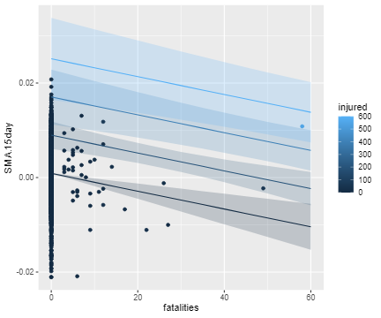
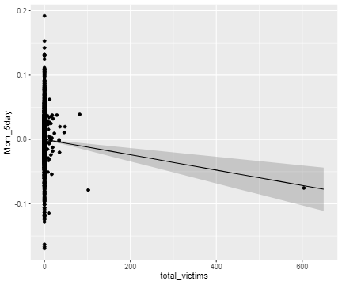





Model Regression Plots
Model 2: SMA_15day ~ fatalities + injured Model 7: MOM_5day ~ total_victims

Slide 22
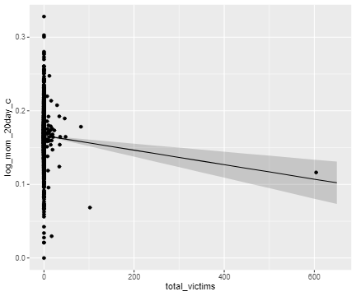


Model Regression Plots Continuation..
Model 8.b: log(MOM_20day + c +1) ~ total_victims

Slide 23
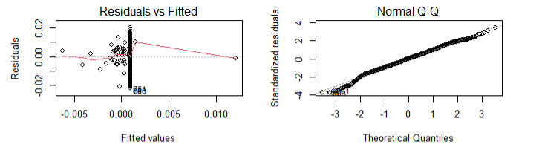
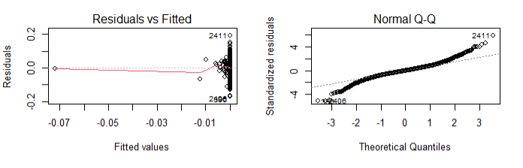
Model Diagnostic Plots
Model 2: SMA_15day ~ fatalities + injured
Model 7: MOM_5day ~ total_victims

Slide 24
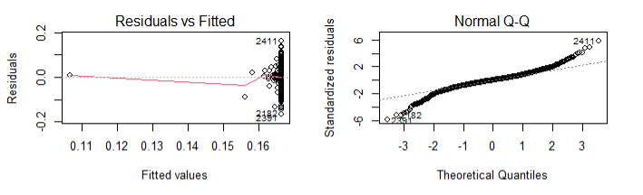
Model Diagnostic Plots Continuation..
Model 8.b: log(MOM_20day + c +1) ~ total_victims

Slide 25
Model Evaluation / Performance Metrics
 | Formula | R^2 & Adj R^2 | RMSE | MAE | MAPE
Model 2 | SMA_15day ~ fatalities + injured Coeffs: intercept:8.629e^-04, fatalities: -1.885e^-04, injured:4.039e^-05 | R^2: 0.003216 Adj R^2: 0.002423 | 0.005951607 | 0.004613019 | 132.9048
Model 7 | MOM_5day ~ total_victims Coeffs: intercept:6.203e^-05, total_victims: -1.191e^-04 | R^2: 0.0021 Adj R^2: 0.001703 | 0.03653719 | 0.02632611 | 99.66629
Notes:
Further go through EDA

Slide 26
Final Model
SMA_15day ~ fatalities + injured
Coeffs: intercept:8.629e^-04, fatalities: -1.885e^-04, injured:4.039e^-05
Better explanatory power
Interpretation:
For unit increase in fatality, 15 day avg. return drops by 1.885e^-04
Roughly, 21% change in daily return while holding all else constant.
Metrics:
R^2 | 0.003216
Adjusted R^2 | 0.002423
MAE | 0.004613019
RMSE | 0.005951607
MAPE | 132.9048
Notes:
What models did we think about and why we chose Linear Regression?

Slide 27
Conclusion

Slide 28
Interesting Expenditure to Pursue
Investigate additional datasets like Options chain data of gun industry stocks
Explore other variables from the Stock data like Volume, twitter sentiment analysis on mass shootings vs markets returns
Explore at acquiring gun sales data for further analysis
Explore the impact on return for those companies that are not publicly traded
More advanced modeling techniques - Random Forest Regression, Ensemble learning techniques

Slide 29
Key Takeaways
No long term impact on Gun industry stocks
There is significant impact on stock returns due to mass shooting
Impact fades away beyond a week

Slide 30
Source Cited
FBI. (2016, June 9). Active shooter resources. FBI. Retrieved July 16, 2022, from https://www.fbi.gov/about/partnerships/office-of-partner-engagement/active-shooter-resources
Daniel, W. (2022, May 25). Gunmakers' stocks rise after Texas School shooting leaves 19 children and two teachers dead. Fortune. Retrieved July 16, 2022, from https://fortune.com/2022/05/25/uvalde-school-shooting-gun-stocks-rise/
Gopal, A., & Greenwood, B. N. (2017, May 18). Traders, guns, and money: The effects of mass shootings on stock prices of firearm manufacturers in the U.S. PloS one. Retrieved July 16, 2022, from https://www.ncbi.nlm.nih.gov/pmc/articles/PMC5436715/
Dancho, M. (2022, May 20). Core functions in tidyquant. Retrieved July 16, 2022, from https://cran.r-project.org/web/packages/tidyquant/vignettes/TQ01-core-functions-in-tidyquant.html
Usmani, Z.-ul-hassan. (2022, May 25). US mass shootings. Kaggle. Retrieved July 17, 2022, from https://www.kaggle.com/datasets/zusmani/us-mass-shootings-last-50-years?datasetId=2778&sortBy=dateRun&tab=collaboration&select=US%2BMass%2BShootings%2BMay%2B24%2B2022.csv
Team, T. I. (2022, May 11). Momentum indicates stock price strength. Investopedia. Retrieved July 17, 2022, from https://www.investopedia.com/articles/technical/081501.asp
Hayes, A. (2022, June 13). Simple moving average (SMA). Investopedia. Retrieved July 17, 2022, from https://www.investopedia.com/terms/s/sma.asp
Notes:
https://www.citationmachine.net/ APA7

Slide 31
Thank You

